Slide 1
Procedural Animation
By: Cole Mollica

Slide 2
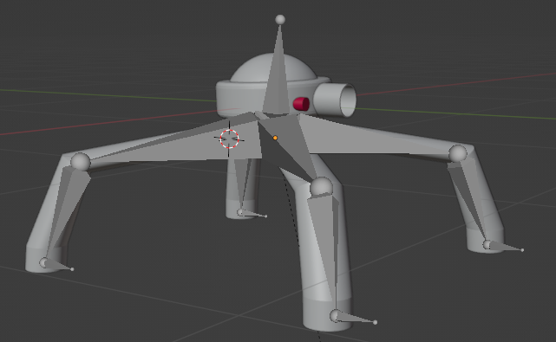
Prerequisites
A rigged character with at least 2 bones.
The bones weight must be be painted
The Animation Rigging Package needs to be installed in unity

Slide 3
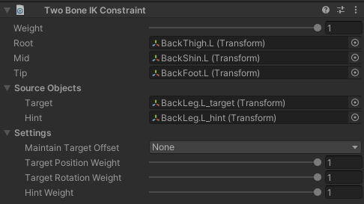
How To Setup
A rig builder and animator component needs to be added to your character
Rigs than need to be added to character
Each child in the rig needs a Two Bone IK Constraint.
The tip transform and/or mid and/or root transform needs to be specified
The Two Bone IK Constraint will then generate a Target and Hint transform
Example can be found of next slide

Slide 4
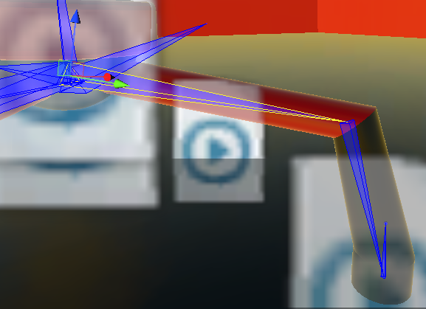
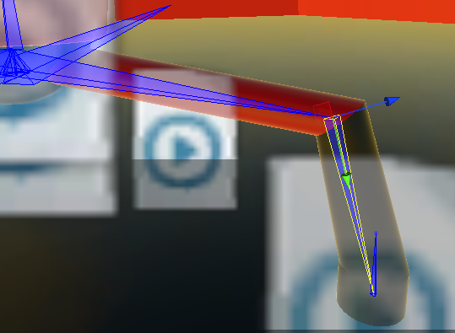
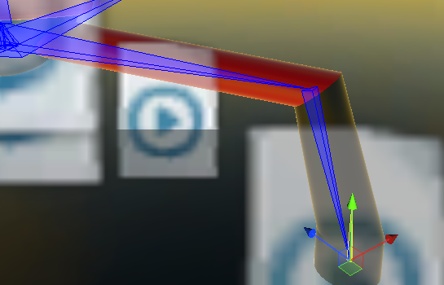
Tip, Mid, Root Example
Root
Mid
Tip

Slide 5
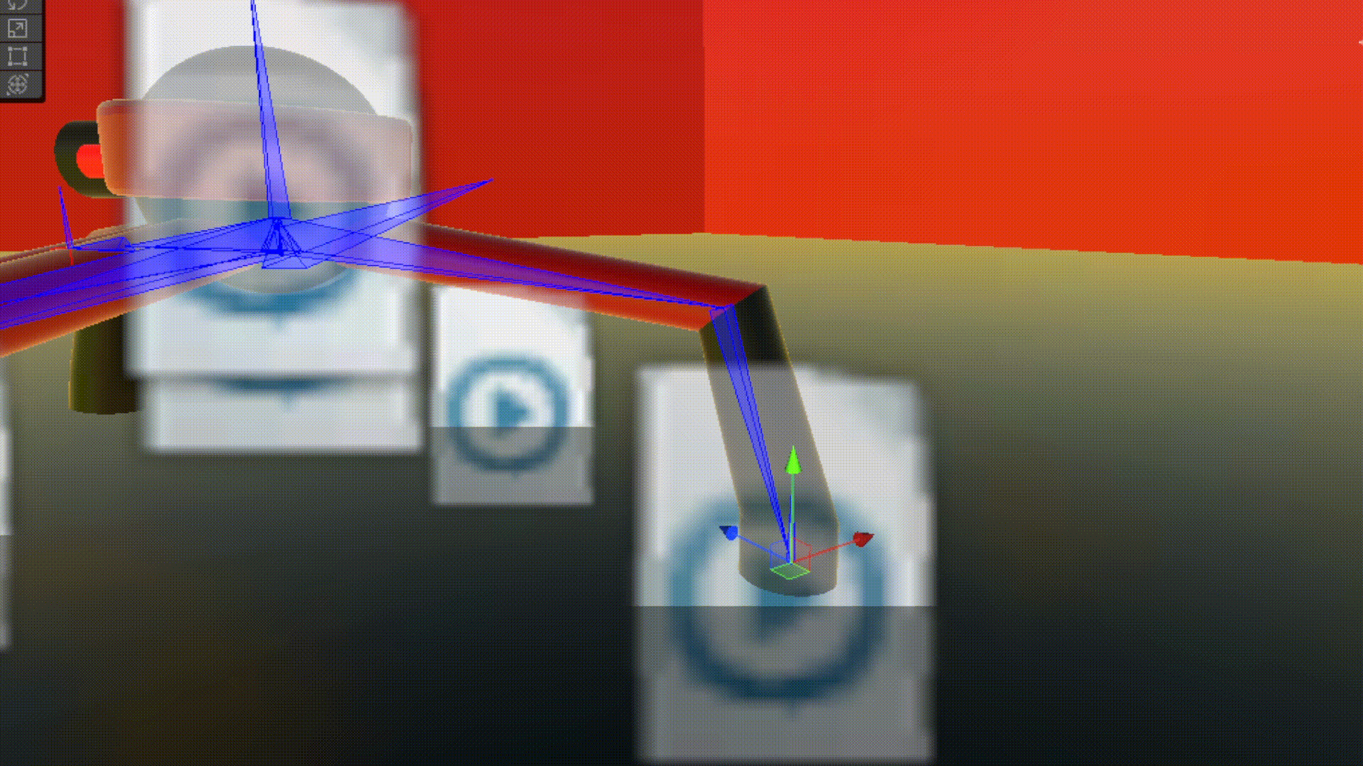
Target and Hint
The target transform controls the position of the tip, which will cascade upwards and control the position of the mid and the root
The hint transform is similar to the target, but its effect are more similar to controlling the rotation instead of position
By manipulating these two transforms complex movement animations can be generated using scripts

Slide 6


Good Resources
Unity’s YouTube
https://www.youtube.com/watch?v=acMK93A-FSY
Animation Rigging Package Manual
https://docs.unity3d.com/Packages/com.unity.animation.rigging@0.2/manual/index.html

